Slide 1
Quarterly Event Results Review with Jen
[Industry/FSM/Pub/Fed/Horizon/Consulting/Strategic Partners]

Slide 2
[Event Name], [Brief ID], [Event Date]
[Link to POR]
Expected Individuals | Actual Individuals | Delta
Expected SQOR by end of QX | Actual SQOR as of | Delta (+/-)
[Paste screenshot of EPM dashboard]
% Named Accounts (# of Named/Total Attendees)
X%
% Horizon Accounts (# of Horizon/Total Attendees)
X%
Event Highlights / Future Recommendations
# of meetings onsite / how did they perform Any large deals made/progressed Cool activation or creative idea implemented If we didn’t meet projections, why not?
[Keep, Change, or Remove From Plan]
[Date of EPM pull]
[Insert table of KPI projects]
Notes:
For meetings – consider pulling a report to show what percentage of SQOR meetings are driving
For proprietary, include pipeline in room vs how much has progressed over time (would need to pull from ISC with opportunity number dashboard)
Paste event results slide into POR once updated so Elena has visibility

Slide 3
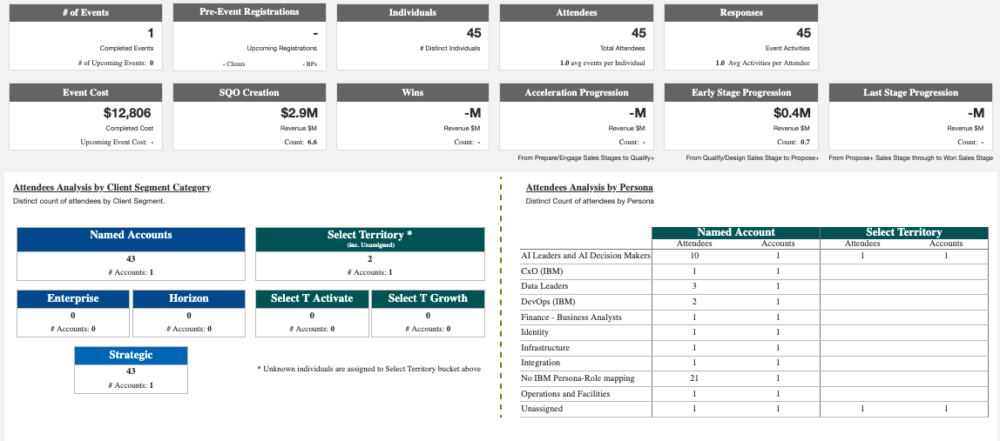
United Supplier Event, LKTXXIMB, March 11
EXAMPLE
Link to POR
Expected Individuals | Actual Individuals | Delta
30 | 45 | +15
Expected SQOR by end of Q2 (CQ+NQ) | Actual SQOR as of 8/13 | Delta (+/-)
$46,800 | $2,900,000 | +$2,853,200
[Paste screenshot of EPM dashboard]
% Named Accounts (# of Named/Total Attendees)
95.5%
% Horizon Accounts (# of Horizon/Total Attendees)
0%
Event Highlights / Future Recommendations
Simple presence – tabletop with monitor Important accounts/contacts in the room – event specifically for CIO organization of United Important to have a presence to maintain relationship
Keep in Plan
Pulled 8.13
KPI Projections
Event name | Brief | UT 15 | UT 17 | CQ | NQ | NQ+1 | NQ+2 | Total
United Supplier Event | LKTXXIMB | Data Platform | AI Productivity | $19,890 | $26,910 | $29,250 | $40,950 | $117,000
[Insert table of KPI projects]
Notes:
Clarify Individuals vs Engagements
Elena also thinks we should call out engagements (multi-touch)

Slide 4
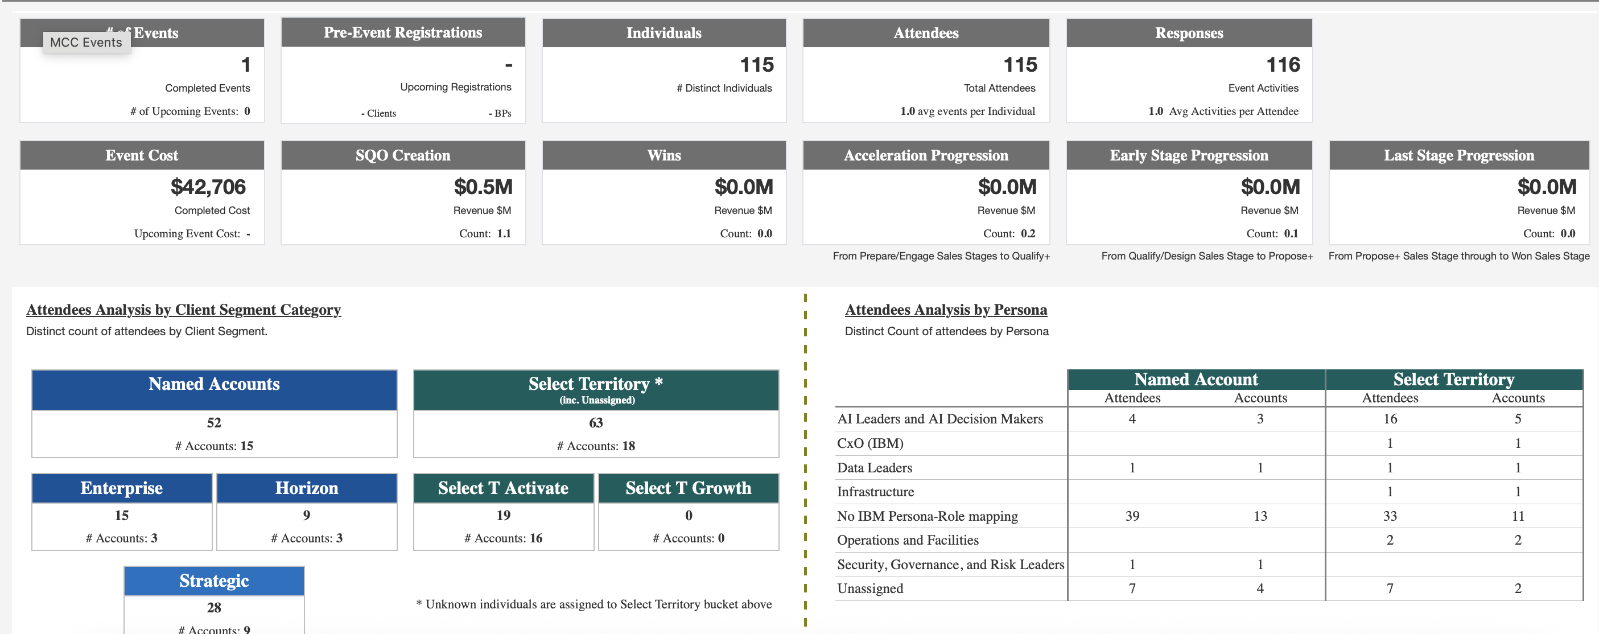
SAE WCX 2026, CLXLAQMB, April 14-16
EXAMPLE
Link to POR
Expected Individuals | Actual Individuals | Delta
100 | 115 | +15
Expected SQOR by end of Q2 | Actual SQOR as of 7/19 | Delta
$75,796 | $500,000 | +$424,204
[Paste screenshot of EPM dashboard]
% Named Accounts (# of Named/Total Attendees)
45%
% Horizon Accounts (# of Horizon/Total Attendees)
8%
Event Highlights / Future Recommendations
Show did not make it clear how engineer-heavy the audience was. Connected only with engineers and very few decision-makers. Results must be from pre-existing discussions, booth staff expressed they had no valuable conversations onsite Had floor stands for IBV reports, worked very well for this audience
Remove from Plan
Pulled 7/19
KPI Projections
Event name | Brief | UT 15 | UT 17 | CQ | NQ | NQ+1 | NQ+2 | Total
SAE WCX 2026 | CLXLAQMB | Data Platform | AI Productivity | $75,796 | $102,547 | $111,465 | $156,050 | $445,858

Slide 5
Q1 Events

Slide 6
Q2 Events

Slide 7
Q3 Events

Slide 8
Q4 Events

